Slide 1
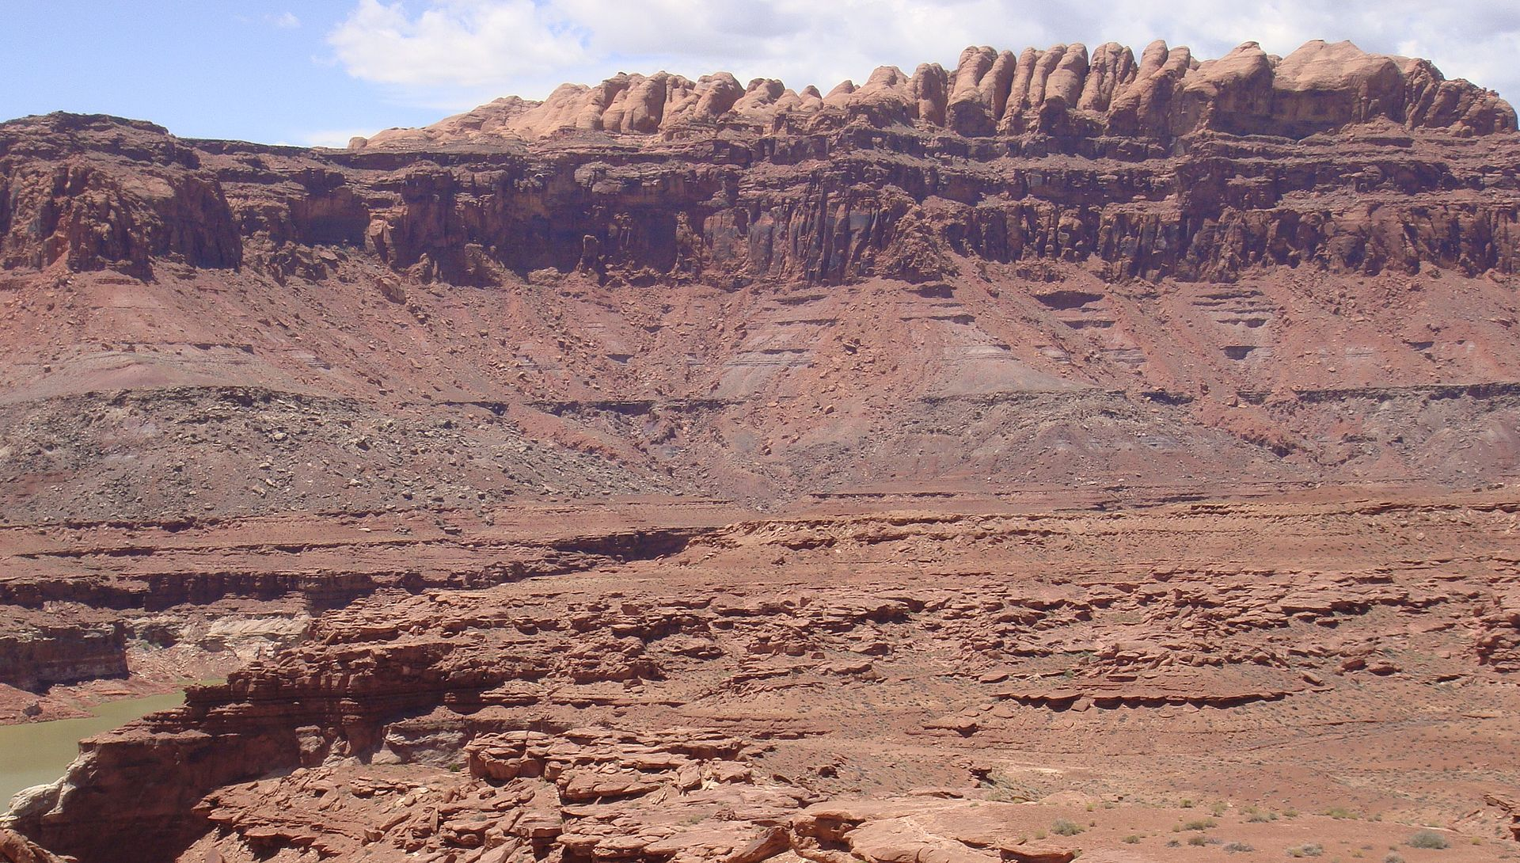
Principles of Stratigraphy

Slide 2
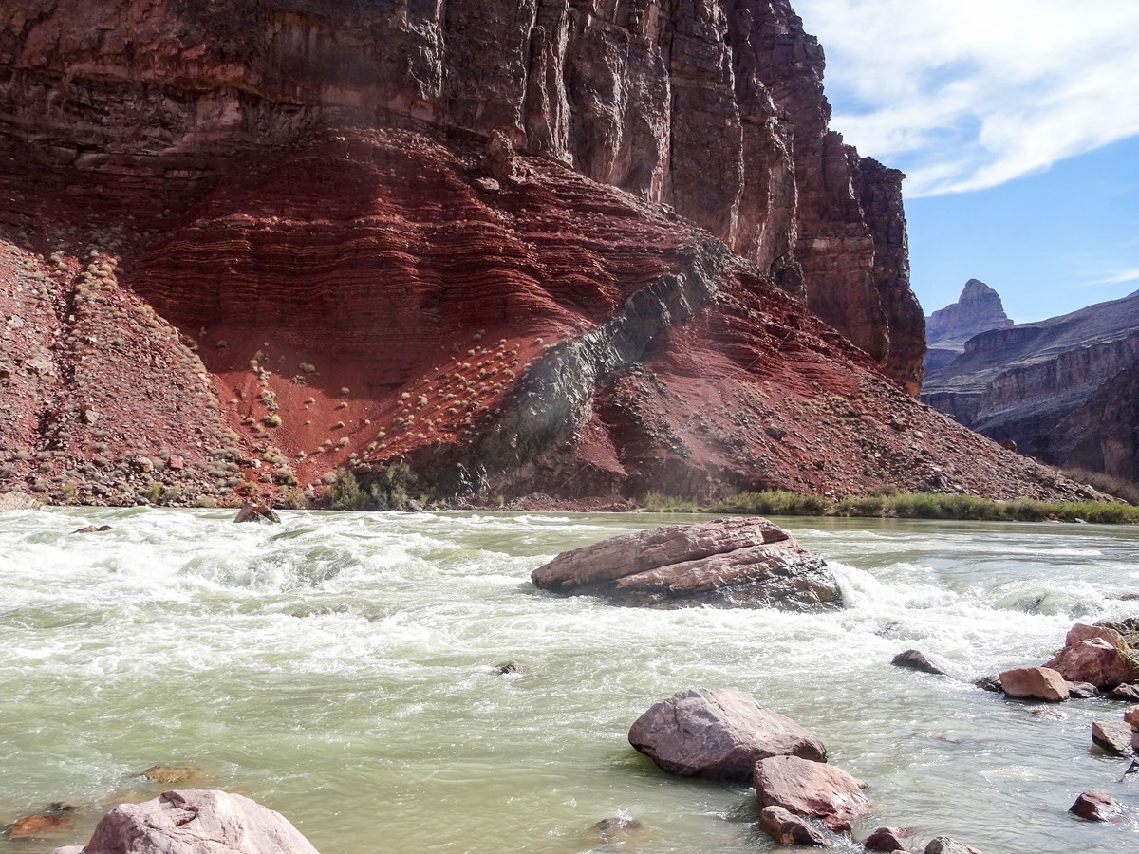
Introduction
This is a picture from the bottom of the Grand Canyon. There are three different rock beds here… can you spot them? (Hint: look for differences in color, orientation, layers, and cliff-forming vs non-cliff forming.) What rocks do you think formed first? Which do you think formed last? How can we tell when each rock formed?
Notes:
There’s space to answer these questions and write down observations on the handout.

Slide 3
Introduction
This is a picture from the bottom of the Grand Canyon. There are three different rock beds here… can you spot them? (Hint: look for differences in color, orientation, layers, and cliff-forming vs non-cliff forming.) What rocks do you think formed first? Which do you think formed last? How can we tell when each rock formed?
Notes:
Discuss with students. Here are the three rock units outlined. Students should note that the rocks on the bottom probably had to be in place for the rocks on top to form. Students should also note that the blue-outlined rock cuts through the orange-outlined rock layer, suggesting that the orange-outlined rock layer was present first. This discussion should lead into the concept of how we can understand the relationships between rock layers (as in, what came first).

Slide 4
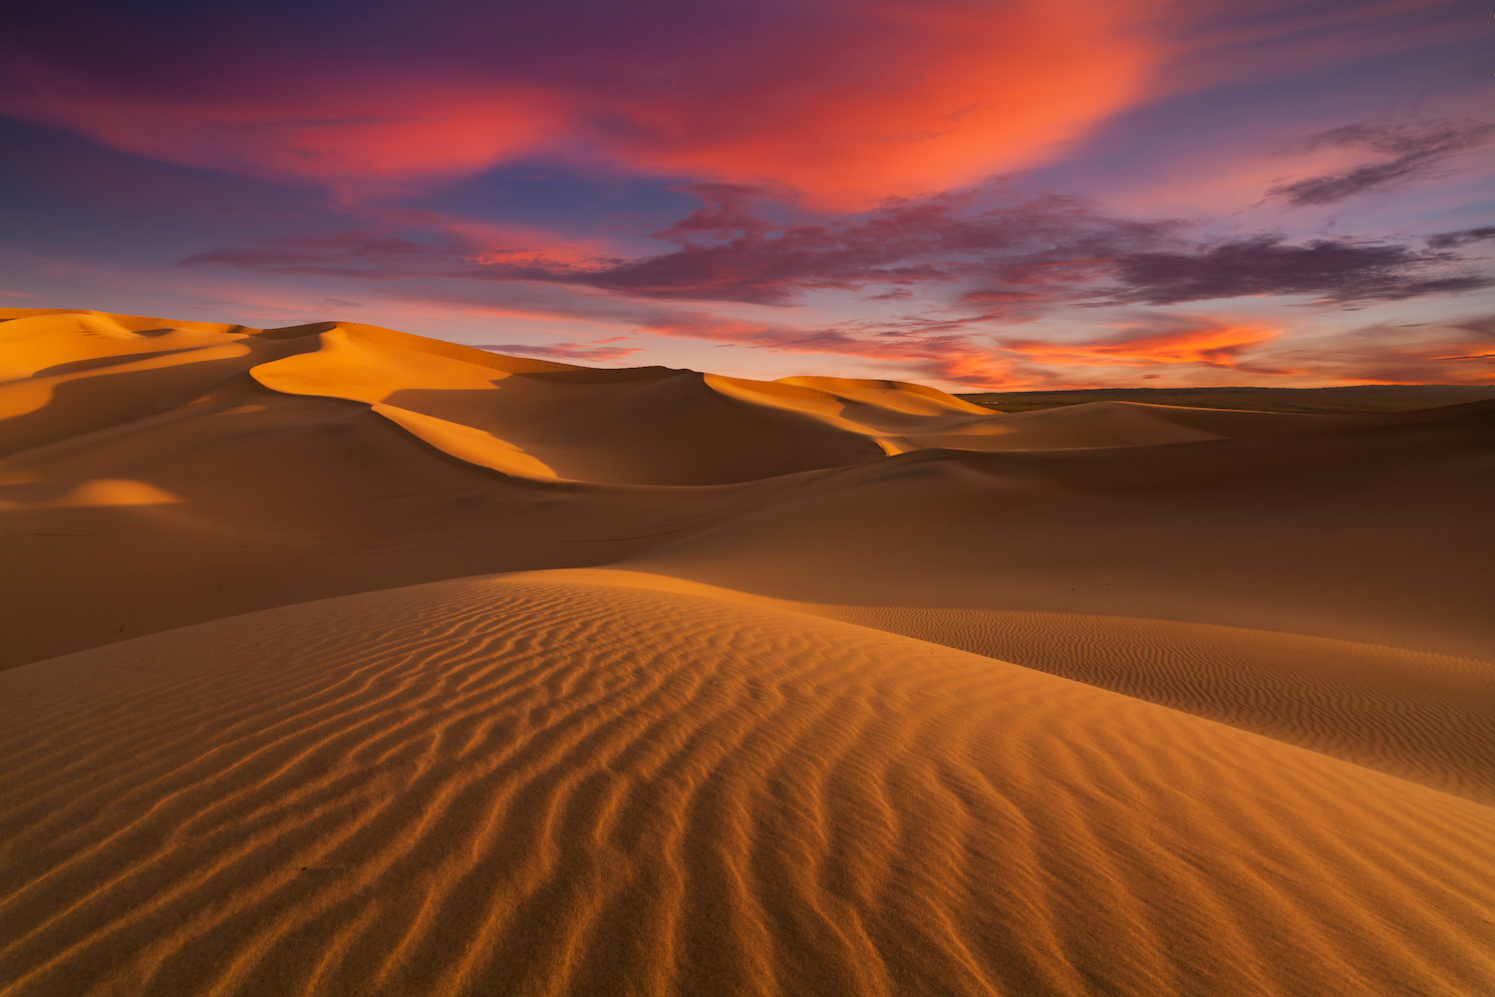
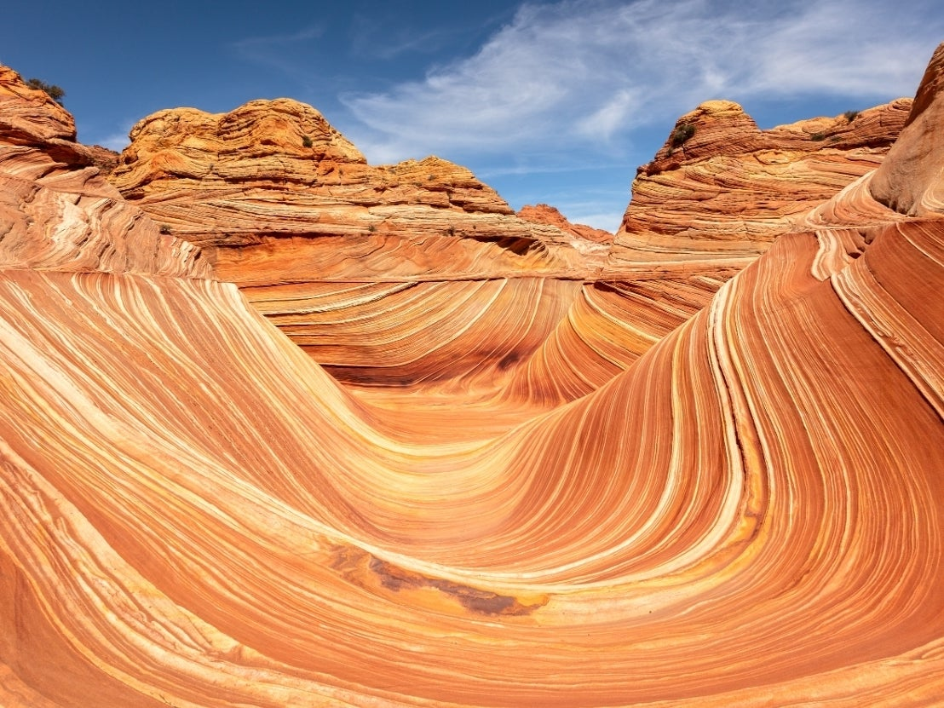
Why do sedimentary rocks matter?
Sedimentary rocks form from eroded fragments of other rocks collected in low lying areas
They are the record of Earth’s surface and past environments
With sedimentary rocks, we can essentially travel back in time to figure out how Earth has changed through its history
Notes:
Sedimentary rocks are important because we want to understand what the earth looked like in the past.

Slide 5
How can we tell how old rocks are?
Absolute Dating
Relative Dating
Absolute dating uses chemistry to figure out when certain minerals formed, based on elemental ratios
Two big ones:
Carbon-14
Uranium in zircons
However….. not really useful for old sedimentary rocks
Relative dating is determining which rocks are older or younger relative to each other, when we don’t have absolute dates. So this method can tell us that Rock Y is older than Rock W, but younger than Rock Z
Notes:
There are two main ways that we can date rocks: absolute dating and relative dating. Absolute dating can provide specific dates (like 220 million years ago), while relative dating can tell us how old a rock is relative to another. However, absolute dating does not work for many sedimentary rocks, as sedimentary rocks are composed of fragments that have been eroded from existing rocks (so dating those minerals will tell us when the original rock formed, not when the sedimentary rock formed).

Slide 6
Principles of Stratigraphy
Stratigraphy = study of rock layers and their relationships
Stratigraphy is used for relative dating and correlating rock sequences
These principles help us understand how different stacked rock layers came to be, and what that means
Today, we’ll be discussing these ones:
Superposition
Original horizontality
Cross-cutting relationships
Unconformities

Slide 7
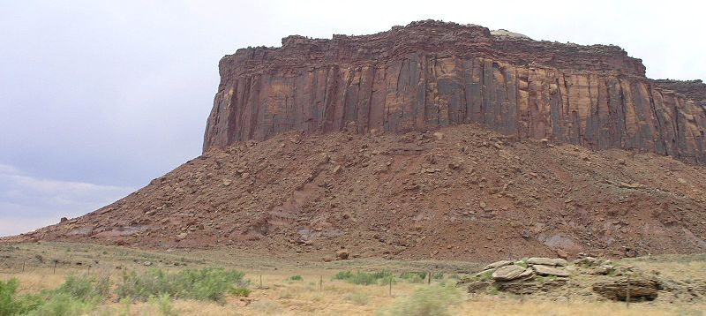
Law of Superposition
Younger rocks are deposited on top of older rocks, so the lower rocks are older, and the higher rocks are younger
Playdoh model: Stack all three colors on each other. What is the relative time order?
Notes:
Create your own playdoh model of this situation. Put down the layer in the first color, then stack the second color, then third color on top. Write down in the handout the time order sequence of your model.

Slide 8
Law of Superposition
This is an outcrop near Canyonlands National Park in southern Utah
Using the Law of Superposition, what is the order of events?
1.
2.
3.

Slide 9
Law of Superposition
This is an outcrop near Canyonlands National Park in southern Utah
Using the Law of Superposition, what is the order of events?
1. Layer A deposited
2.
3.

Slide 10
Law of Superposition
This is an outcrop near Canyonlands National Park in southern Utah
Using the Law of Superposition, what is the order of events?
1. Layer A deposited
2. Layer B deposited
3.

Slide 11
Law of Superposition
This is an outcrop near Canyonlands National Park in southern Utah
Using the Law of Superposition, what is the order of events?
1. Layer A deposited
2. Layer B deposited
3. Layer C deposited

Slide 12
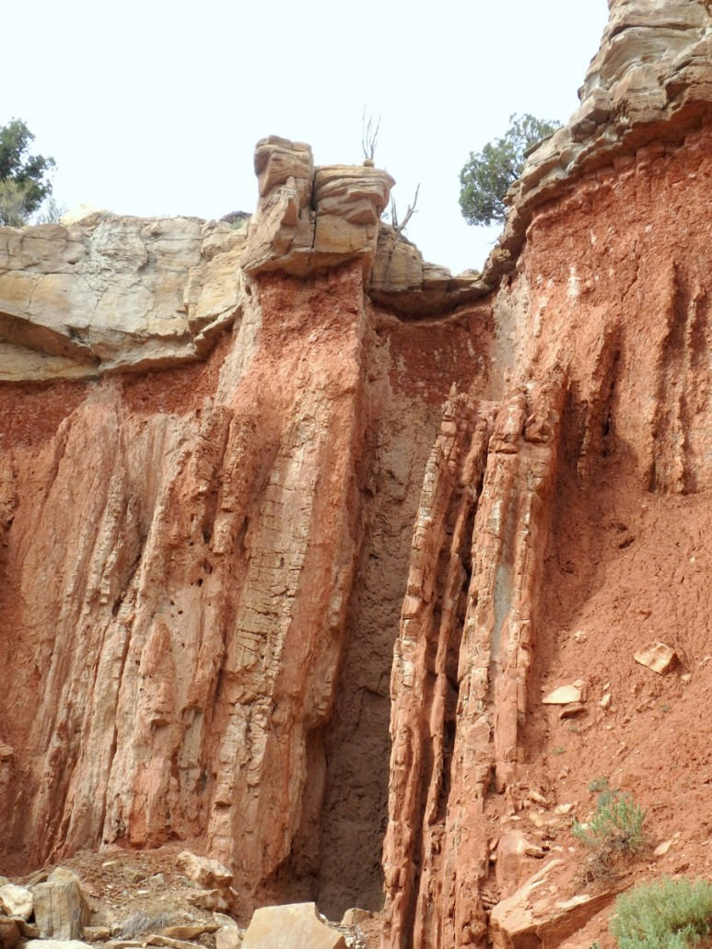
Original Horizontality
Sedimentary rocks are initially deposited flat, due to gravity
So, if sedimentary rocks are tilted or folded, another event tilted or folded them after deposition
Playdoh model: Stack two colors on each other, then tilt them. Stack the third color on top. What is the relative time order?
Notes:
Create your own playdoh model of this situation. Put down the layer in the first color, then stack the second color. Then tilt the two layers and stack the third color on top. Write down in the handout the time order sequence of your model.
For interest: rock layers are usually tilted by tectonic events, like the mountain building event that created the Rocky Mountains (and these tilted layers here)!

Slide 13
Original Horizontality
This is a rock outcrop in Salina, Utah (about 2 hours south of Salt Lake City!)
What is the order of events here?
1.
2.
3.

Slide 14
Original Horizontality
This is a rock outcrop in Salina, Utah (about 2 hours south of Salt Lake City!)
What is the order of events here?
1. Layer A deposited flat
2.
3.

Slide 15
Original Horizontality
This is a rock outcrop in Salina, Utah (about 2 hours south of Salt Lake City!)
What is the order of events here?
1. Layer A deposited flat
2. Layer A tilted 90 degrees
3.

Slide 16
Original Horizontality
This is a rock outcrop in Salina, Utah (about 2 hours south of Salt Lake City!)
What is the order of events here?
1. Layer A deposited flat
2. Layer A tilted 90 degrees
3. Layer B deposited on top

Slide 17
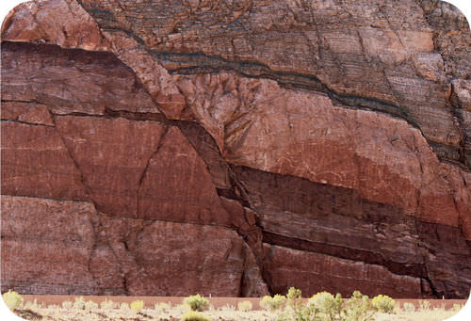
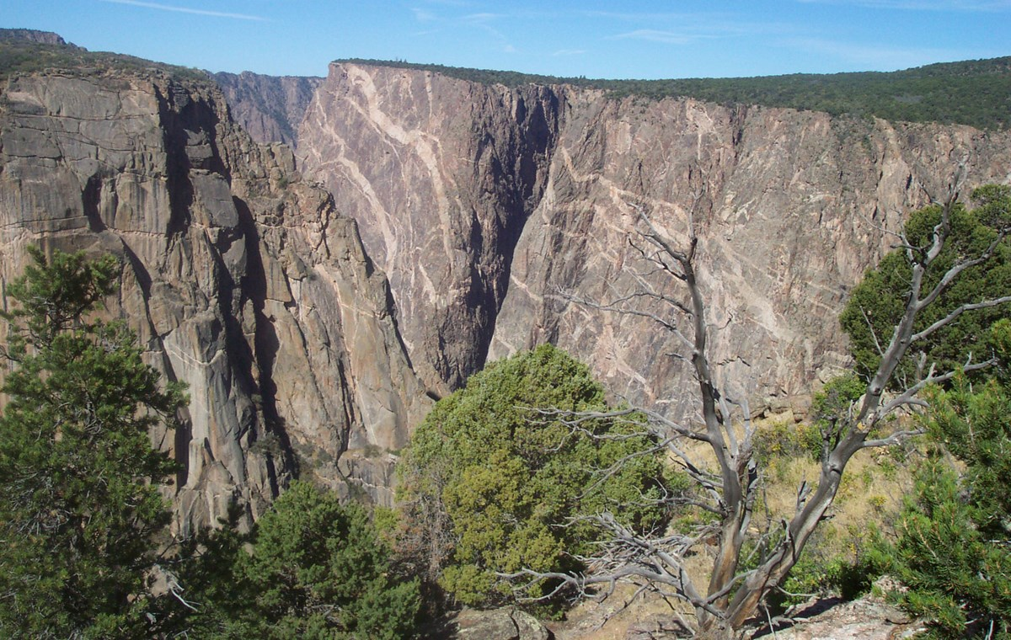
Cross-cutting Relationships
Features that cut across rock layers are younger than the rocks that they cross
Some features that may do this include faults, volcanic intrusions, and veins
Playdoh model: Stack all three colors. Then, stick a toothpick through them. What is the relative time order?
Notes:
Create your own playdoh model of this situation. Put down the layer in the first color, then stack the second color, then third color on top. Then, stick a toothpick through the layers. Write down in the handout the time order sequence of your model.

Slide 18
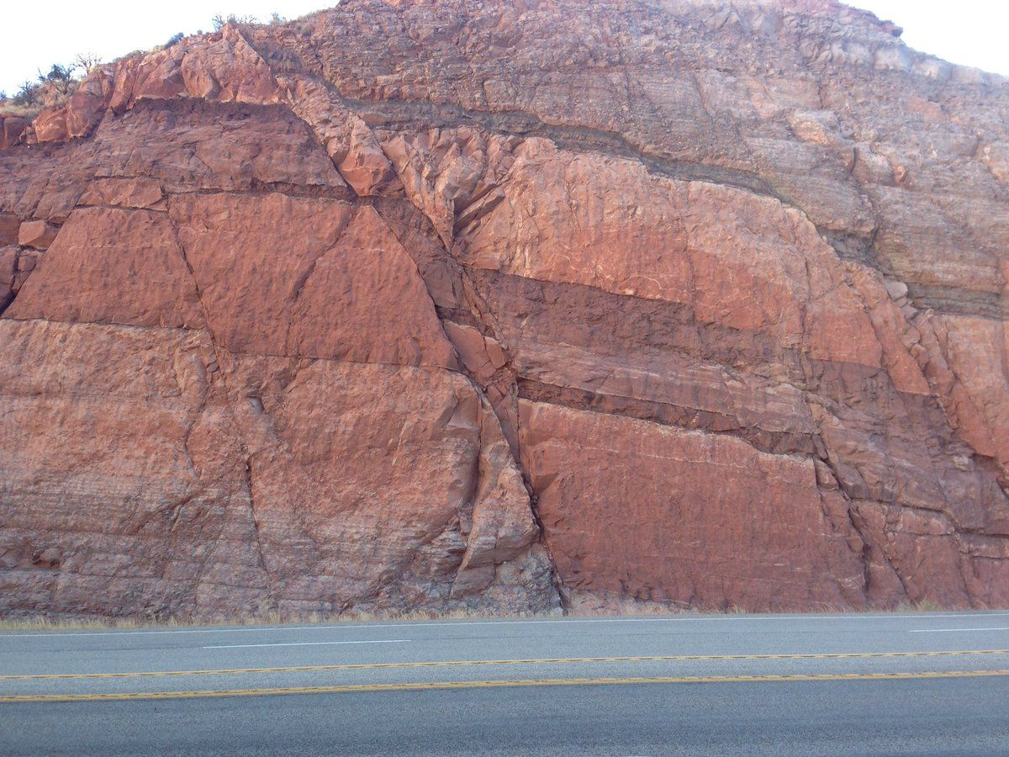
Cross-cutting Relationships
This is the Moab Fault outside of Arches National Park
What is the relative order of events here?
1.
2.
3.
4.
5.
6.

Slide 19
Cross-cutting Relationships
This is the Moab Fault outside of Arches National Park
What is the relative order of events here?
1. Layer A deposited
2. Layer B deposited
3. Layer C deposited
4. Layer D deposited
5. Layer E deposited
6.
Notes:
In this case, 5 layers have been identified, but it may vary based on how closely students look.

Slide 20
Cross-cutting Relationships
This is the Moab Fault outside of Arches National Park
What is the relative order of events here?
1. Layer A deposited
2. Layer B deposited
3. Layer C deposited
4. Layer D deposited
5. Layer E deposited
6. Faulting offsets the layers

Slide 21
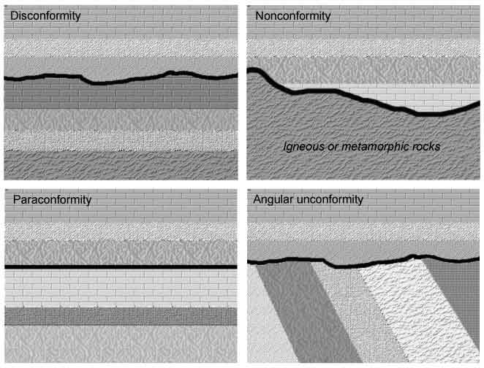
Unconformities
Unconformities are a gap in the geologic record. They occur when there is erosion or a hiatus in deposition between rock beds
So, the underlying bed could be 180 million years old, while the overlying bed could be 30 million years old – a gap of 150 million years!
All other rock sequences are assumed to be conformable (continuous)
There are a few types, including angular unconformities (like the example from Original Horizontality).
Playdoh model: Stack two colors. Scrape off some of Layer 2 with a toothpick. Then stack layer 3 on top.
Notes:
Unconformities are an additional important concept to discuss. They are a gap in the geologic record and are an important part stratigraphy. The image identifies a couple of specific kinds of unconformities, but we will just use the name “unconformity” here. (For reference, the specific kind we’re focusing on is the disconformity, the top left image.)
Create your own playdoh model of this situation. Put down the layer in the first color, then stack the second color. Scrape off some of the second layer with a toothpick, then stack the third color on top. Write down in the handout the time order sequence of your model.

Slide 22
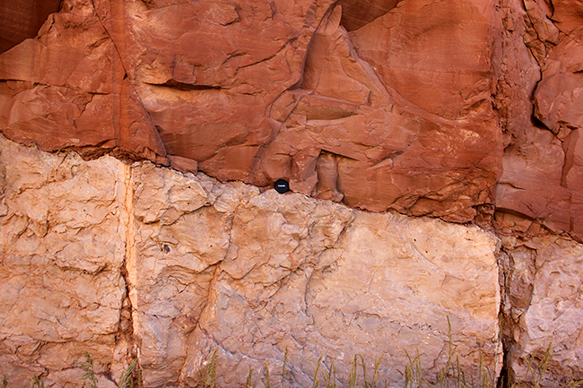
Unconformities
This is an outcrop in Colorado, with red sandstone lying over white limestone.
What is the relative order of events here?
1.
2.
3.

Slide 23
Unconformities
This is an outcrop in Colorado, with red sandstone lying over white limestone.
What is the relative order of events here?
1. Layer A deposited
2.
3.

Slide 24
Unconformities
This is an outcrop in Colorado, with red sandstone lying over white limestone.
What is the relative order of events here?
1. Layer A deposited
2. Layer A eroded, creating the unconformity
3.
Notes:
Note: the squiggly line between layers is specifically how unconformities are marked. If you see a squiggly line in this context, it means that some rock layers are missing, and so there is an unconformity.

Slide 25
Unconformities
This is an outcrop in Colorado, with red sandstone lying over white limestone.
What is the relative order of events here?
1. Layer A deposited
2. Layer A eroded, creating the unconformity
3. Layer B deposited

Slide 26
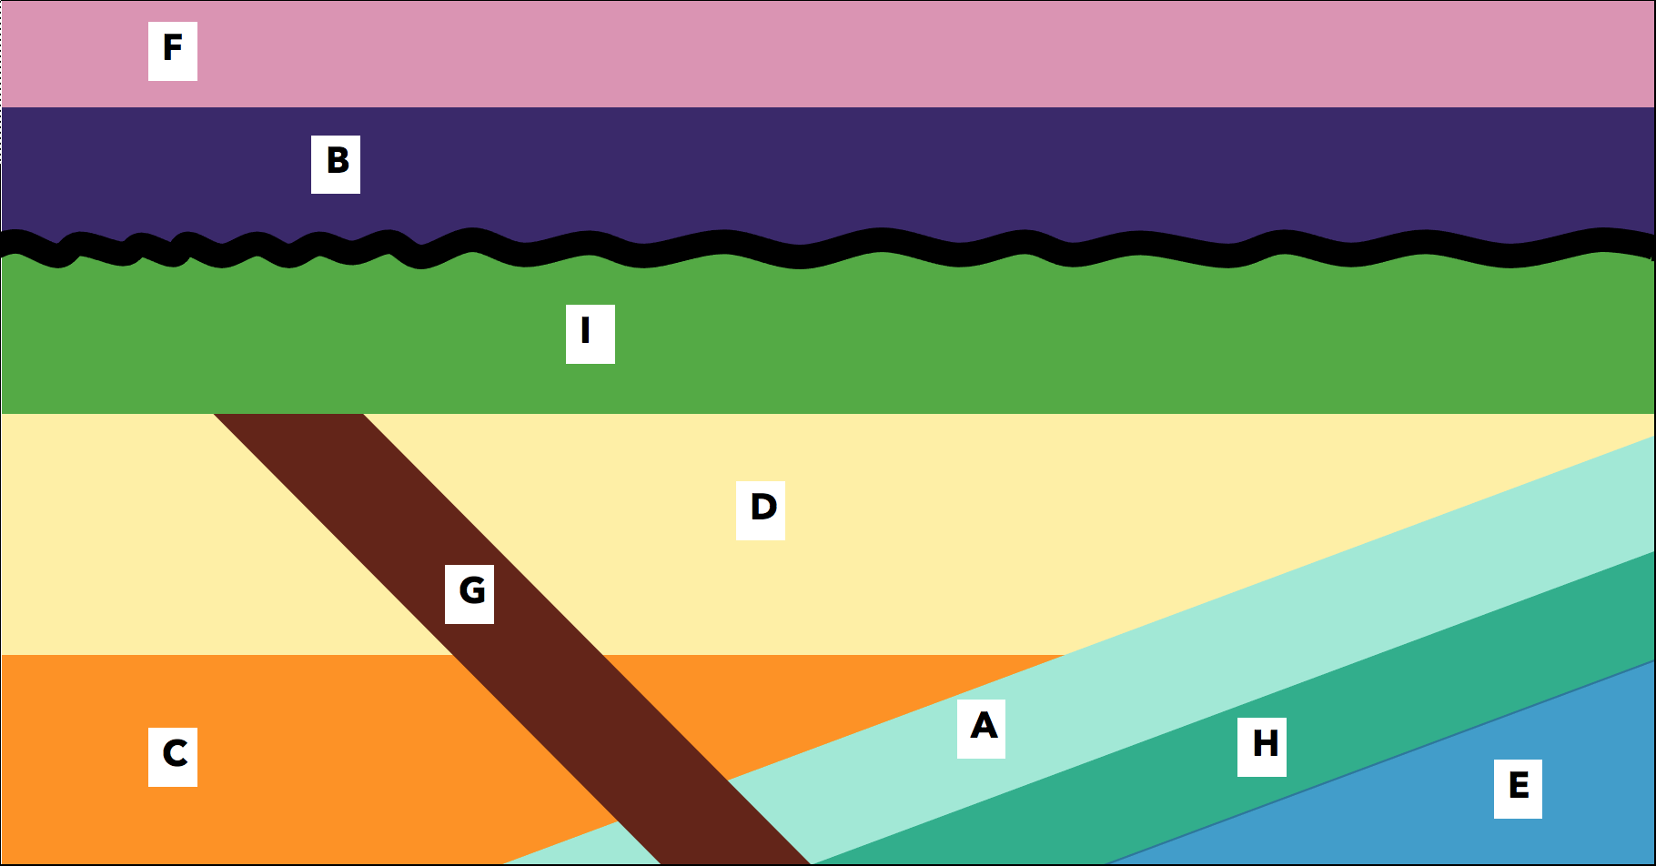
Final Exercise
Using the principles of stratigraphy you’ve learned, figure out which of these rock layers is most likely to contain dinosaur fossils!

Slide 27
Final Exercise
First, put these layers and events in relative time order
Then, look at the information on the different rock layers in your handout
Dinosaurs lived on land from 240-66 million years ago. Based on this information, which layer would you target for dinosaur fossil hunting?
Notes:
For this exercise, students will need to use their knowledge to discover which layer likely contains dinosaur fossils. Based on the information given, they should be looking for rock layers that formed on land (continental environments, not marine), and are younger than 66 million years old. There is one non-sedimentary rock (rock G, the volcanic intrusion), which has been chemically dated. Any rock layers the intrusion cuts through are older than that date.
Based on the stratigraphic principles, students should figure out that Layers A, H, and E are too old, while layers I, B, and F are too young. Layers C and D are the correct age to potentially contain dinosaur fossils. Based on the rock information from the handouts, Layer D is most likely to contain fossils because it is a sandstone, and fossils are usually found in sedimentary rocks with sand sized grains or smaller. Layer C is a conglomerate, so the layer probably does not contain fossils, even though it is the correct age.

