Slide 1
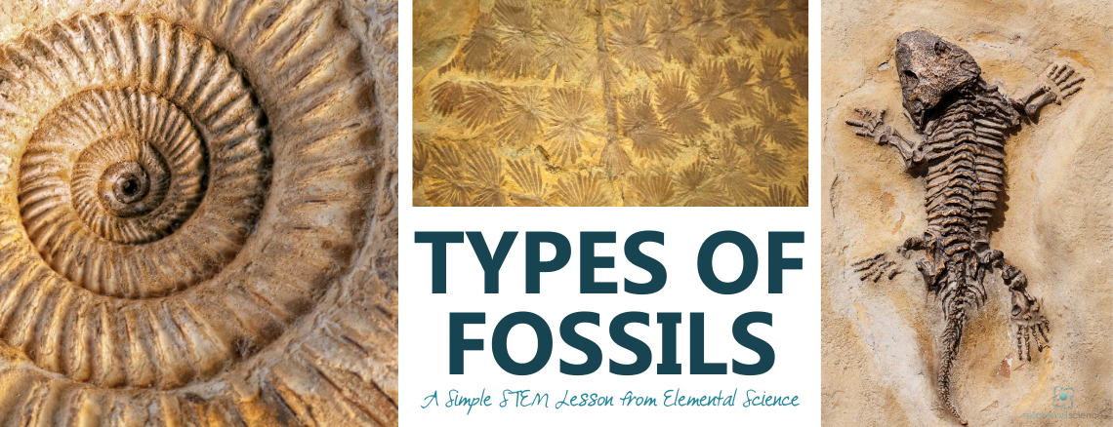
https://elementalscience.com/blogs/science-activities/types-of-fossils-simple-stem-lesson

Slide 2
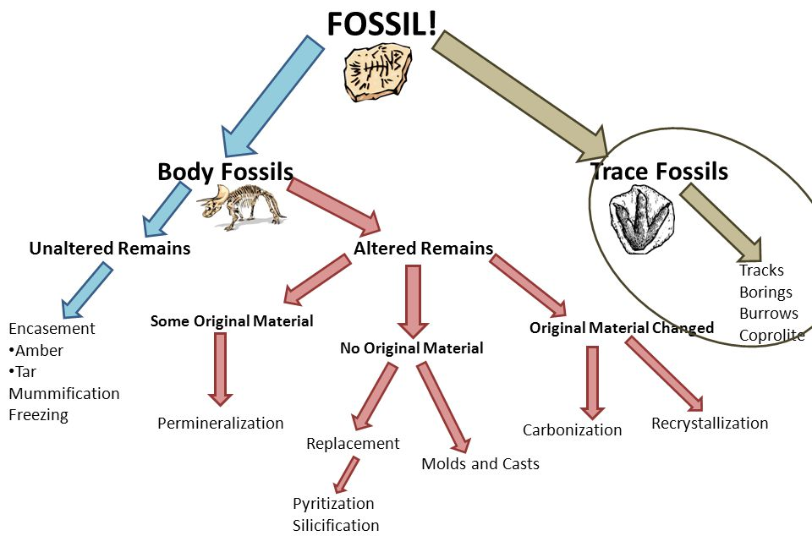
What is a fossil?
A fossil is evidence in rock of past life
Notes:
Body fossils form if the organism dies in, or after death is moved to (by a scavenger, river, or something else), a place where it can be buried and kept from decaying. It could be buried in mud on a lake shore, in tree sap, or other ways.
Bones, teeth, shells, and other hard body parts are less likely to be eaten and take longer to decay, so they are more likely to become fossils.
Over a very long period of time, the heat and pressure from being buried transforms the organisms into fossils.
There are also different ways that fossilization happens, including freezing, drying, petrifaction, perimineralization, asphalt (tar), and carbonization (distillation).
Palaeontologists are scientists who study past life, a lot of them use fossils, but a lot of other paleontologists use:
Modern animals, zoos
Computer models
Physical models.

Slide 3
What are the types of fossils?
Trace
Unaltered remains
Permineralization
Mold and cast
Replacement
Carbonization
Notes:
Body fossils form if the organism dies in, or after death is moved to (by a scavenger, river, or something else), a place where it can be buried and kept from decaying. It could be buried in mud on a lake shore, in tree sap, or other ways.
Bones, teeth, shells, and other hard body parts are less likely to be eaten and take longer to decay, so they are more likely to become fossils.
Over a very long period of time, the heat and pressure from being buried transforms the organisms into fossils.
There are also different ways that fossilization happens, including freezing, drying, petrifaction, perimineralization, asphalt (tar), and carbonization (distillation).
Palaeontologists are scientists who study past life, a lot of them use fossils, but a lot of other paleontologists use:
Modern animals, zoos
Computer models
Physical models.

Slide 4
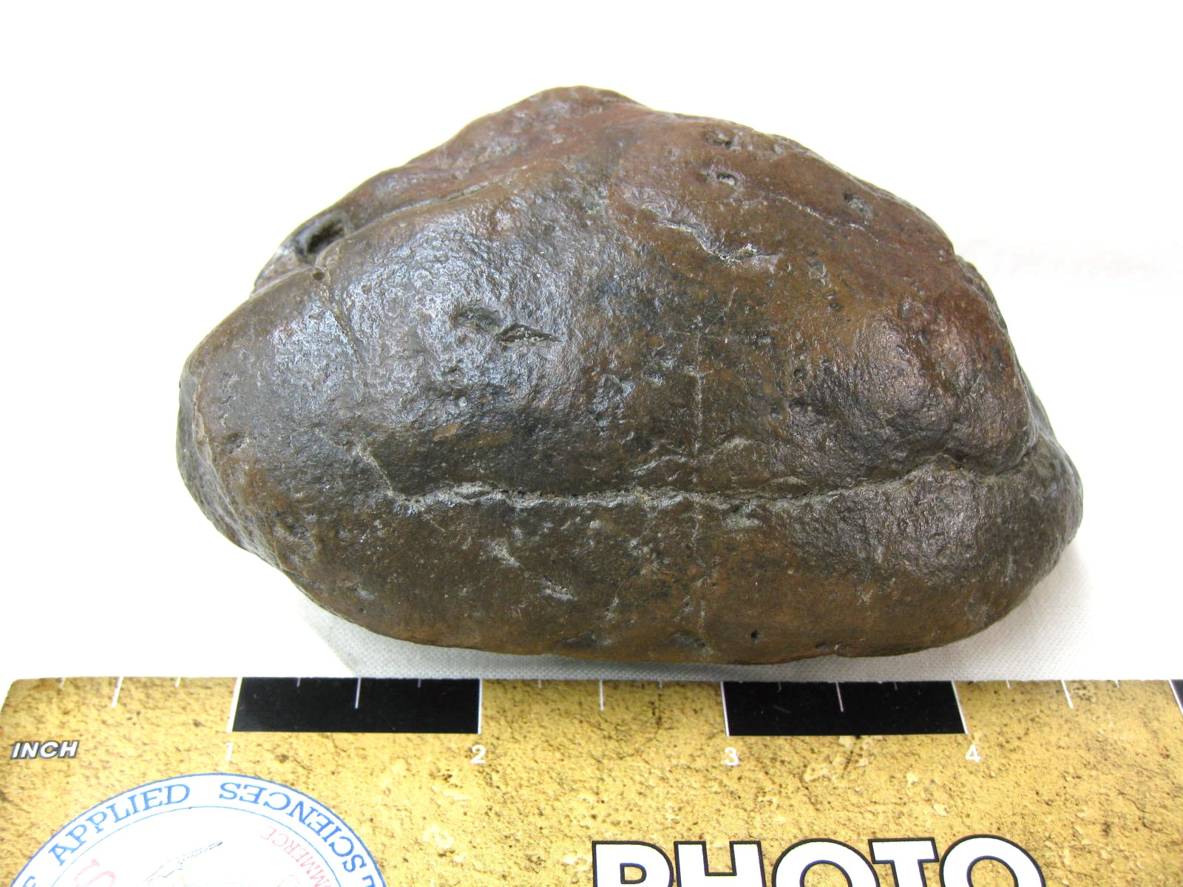
Trace fossil
Definition: Imprints or material left from the activities of life
Examples: burrows, trails, foot prints, and poop
Megalodon shark coprolite

Slide 5
Unaltered remains
Definition: original material is preserved
encasement in amber or tar
mummification or freezing
Notes:
This means you could get DNA!

Slide 6
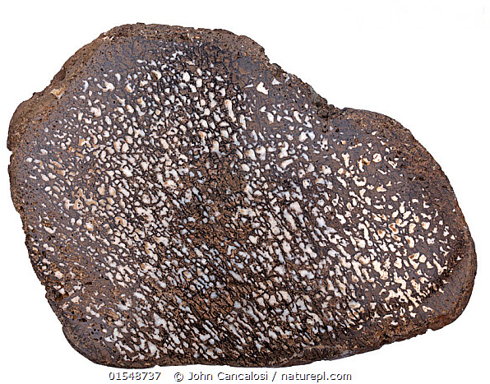
Permineralization
Definition: minerals fill empty spaces
cross section of dinosaur bone, minerals filling holes in bone
petrified tree

Slide 7
Mold and cast
Definitions
Mold: impression of the organism left in the sediment
Cast: mineralized sediment that fills the mold

Slide 8
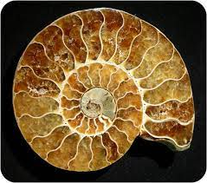
Replacement
Definition: material dissolves and is replaced by a mineral
calcite replacement
pyrite replacement

Slide 9
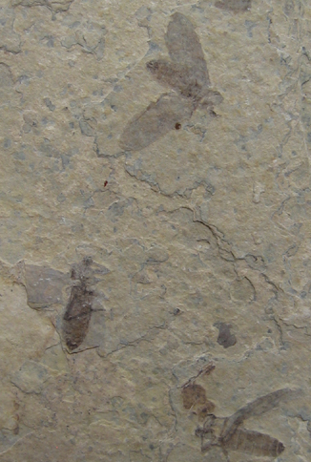
Carbonization
Definition: residual carbon remains as a thin black film
carbonized fish
carbonized insects
http://petrifiedwoodmuseum.org/carbonization.htm

